Slide 1
Statistics
İnvestigating entrepreneurial activity in Azerbaijan and conducting a descriptive analysis (table, diagram and average quantities) in according to its types (micro, small, medium) during 2019-2020
By: M.Aytac

Slide 2
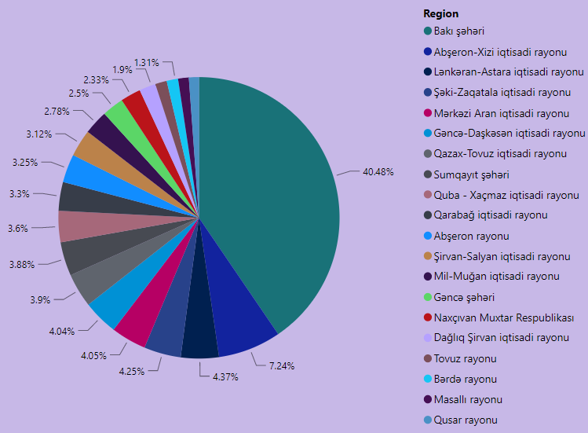
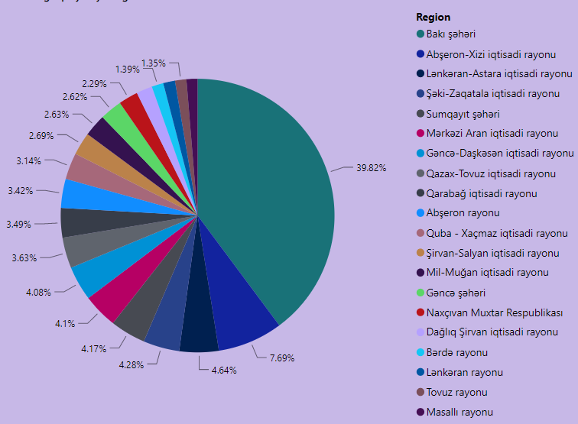
Breakdown of acting micro entrepreneurship subjects according to economic regions, administrative territorial
2019
2020

Slide 3
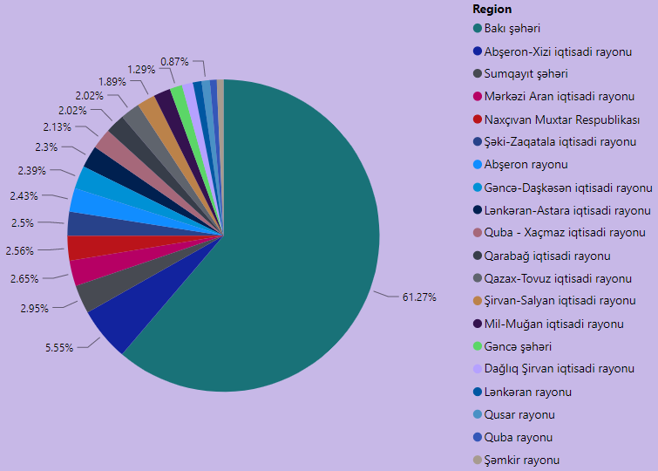
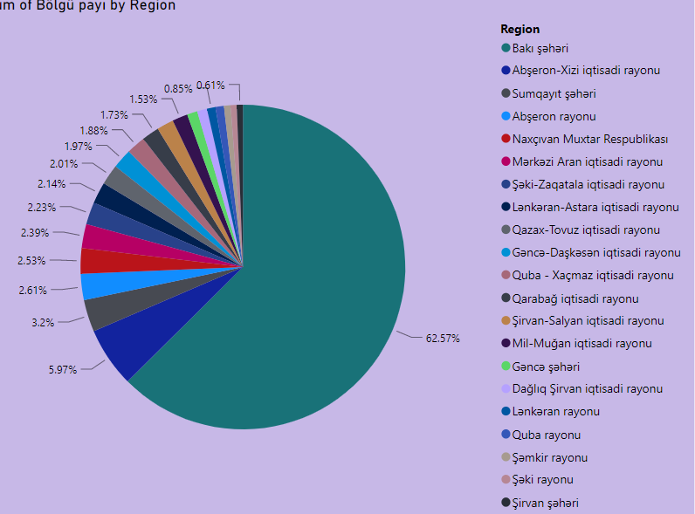
Breakdown of acting small entrepreneurship subjects according to economic regions, administrative territorial
2019
2020

Slide 4
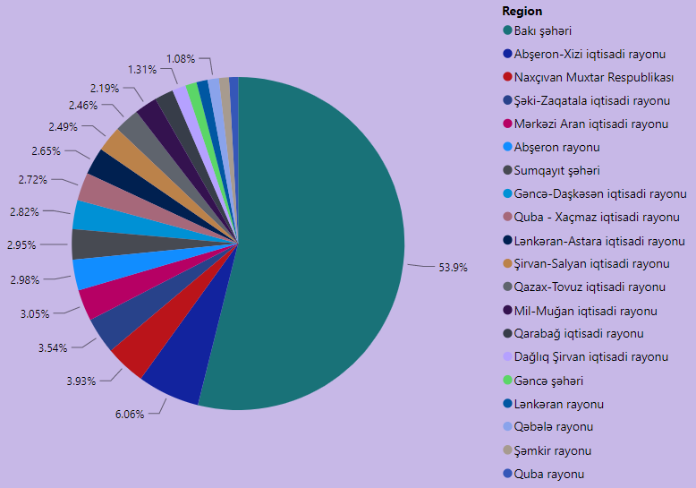
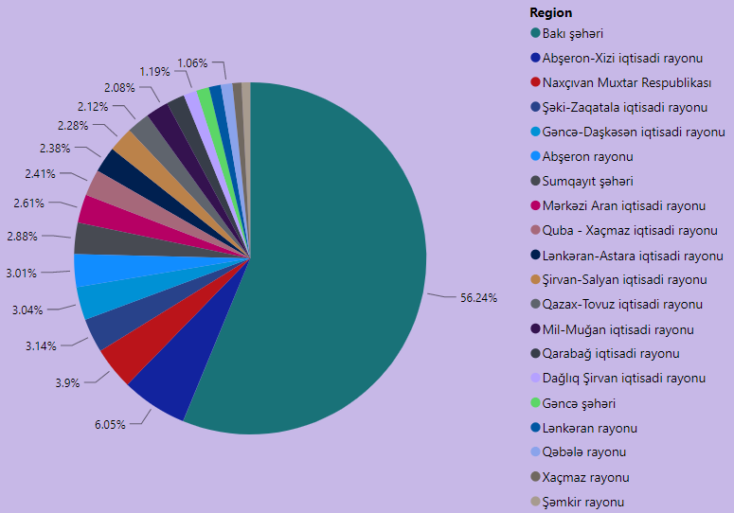
Breakdown of acting medium entrepreneurship subjects according to economic regions, administrative territorial
2019
2020

Slide 5
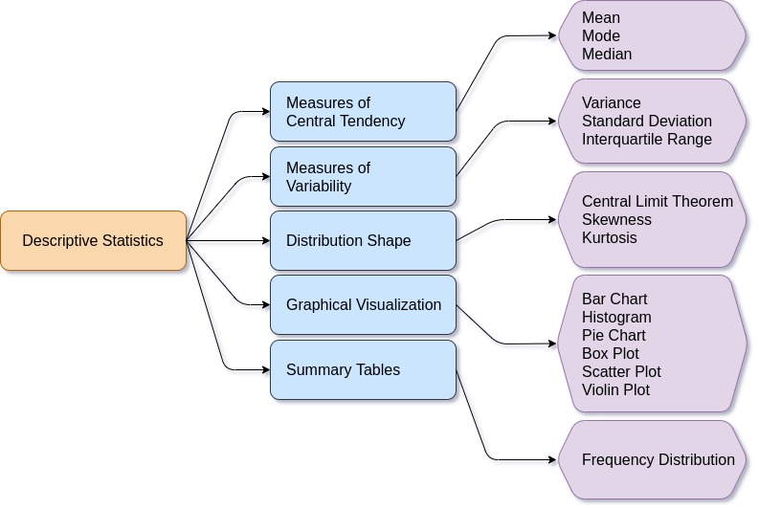
Descriptive statistics
Data ANALYSIS
It is where we describe our data. We use relevant charts to visualize our data so that some meaningful information can be extracted out of it. We should remember that “Data” in itself has no value. We need to apply some transformations or do some visualizations to extract “Information” out of it. Therefore, descriptive statistics helps us in unboxing the hidden secret.
Diagram shows all techniques that falls under descriptive statistics.

Slide 6

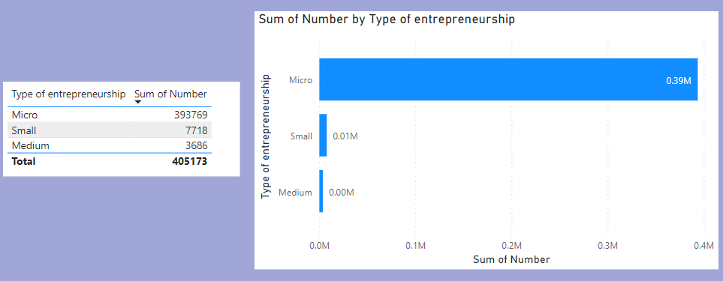
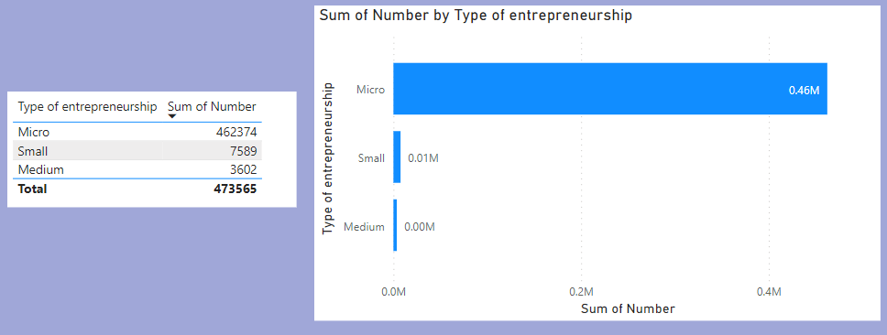
Frequency distribution
2019
A data set is made up of a distribution of values, or scores. In tables or graphs, you can summarize the frequency of every possible value of a variable in numbers or percentages. This is called a frequency distribution.
2020

Slide 7

Measures of central tendency
A measure of central tendency is a single value that attempts to describe a set of data by identifying the central position within that set of data. The mean, median and mode are 3 ways of finding the average.
The mean (or average) is the most popular and well known measure of central tendency. It can be used with both discrete and continuous data, although its use is most often with continuous data. The mean is equal to the sum of all the values in the data set divided by the number of values in the data set. The mean has one main disadvantage: it is particularly susceptible to the influence of outliers. These are values that are unusual compared to the rest of the data set by being especially small or large in numerical value. So, if we have n values in a data set and they have values X1,X2, …,Xn, the sample mean, usually denoted by xⁿ― (pronounced "x bar"), is:

Slide 8
Median
The median is the middle score for a set of data that has been arranged in order of magnitude. The median is less affected by outliers and skewed data. In order to calculate the median, suppose we have the data below:
65 | 55 | 89 | 56 | 35 | 14 | 56 | 55 | 87 | 45 | 92
We first need to rearrange that data into order of magnitude (smallest first):
14 | 35 | 45 | 55 | 55 | 56 | 56 | 65 | 87 | 89 | 92
Our median mark is the middle mark - in this case, 56 (highlighted in bold). It is the middle mark because there are 5 scores before it and 5 scores after it. This works fine when you have an odd number of scores, but what happens when you have an even number of scores? What if you had only 10 scores? Well, you simply have to take the middle two scores and average the result. So, if we look at the example below:
65 | 55 | 89 | 56 | 35 | 14 | 56 | 55 | 87 | 45
We again rearrange that data into order of magnitude (smallest first):
14 | 35 | 45 | 55 | 55 | 56 | 56 | 65 | 87 | 89
Only now we have to take the 5th and 6th score in our data set and average them to get a median of 55.5.

Slide 9
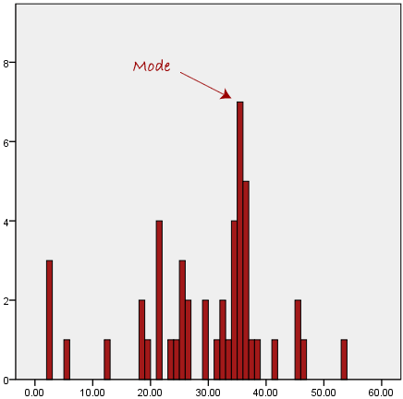
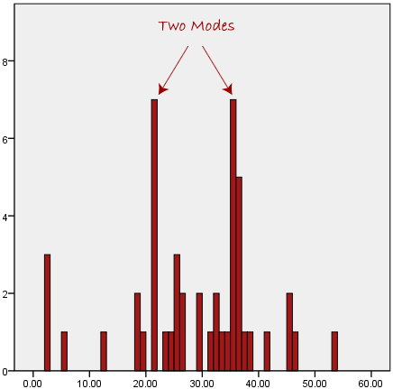
Mode
Data ANALYSIS
The mode is the most frequent score in our data set. On a histogram it represents the highest bar in a bar chart or histogram. You can, therefore, sometimes consider the mode as being the most popular option. An example of a mode is presented below:

Slide 10
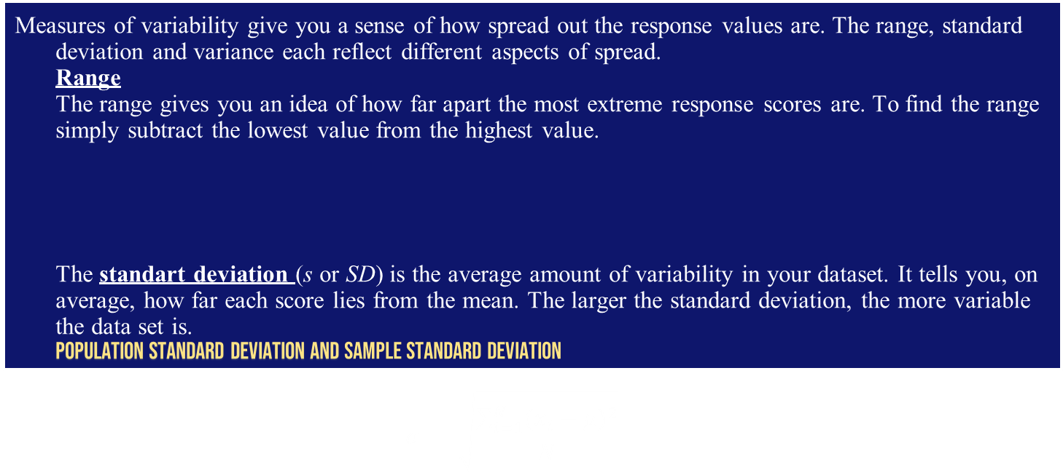
Measures of variability give you a sense of how spread out the response values are. The range, standard deviation and variance each reflect different aspects of spread. Range The range gives you an idea of how far apart the most extreme response scores are. To find the range simply subtract the lowest value from the highest value. The standart deviation (s or SD) is the average amount of variability in your dataset. It tells you, on average, how far each score lies from the mean. The larger the standard deviation, the more variable the data set is. Population Standard Deviation and Sample Standard Deviation $$σ^{ }=\sqrt{\frac{\sum_{i=1}^{N}{{(x_{i}−μ)}^{2}}}{N}}$$
Measures of variability
Range = X_{largest} – X_{smallest} Interquartile range = 3rd quartile – 1st quartile IQR = Q₃ – Q₁

Slide 11


Variance
The variance is the average of squared deviations from the mean. Variance reflects the degree of spread in the data set. The more spread the data, the larger the variance is in relation to the mean.
To find the variance, simply square the standard deviation. The symbol for variance is s².
Population variance
Sample variance

Slide 12
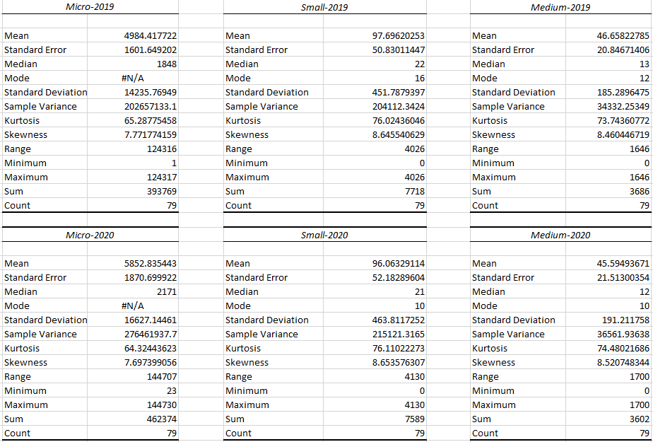
In the Excel program, we calculated descriptive statistics for both 2 years for economic regions, administrative areas.

Slide 13
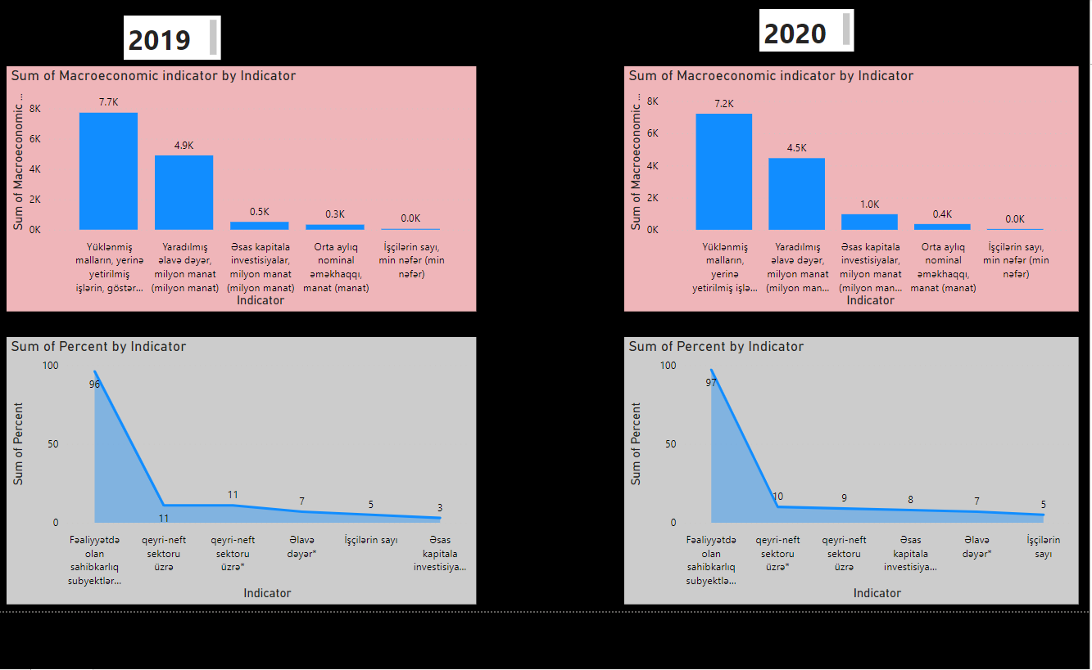

Difference between 2019 and 2020 based on macro-economic indicator and subject shares in micro-entrepreneurship.

Slide 14
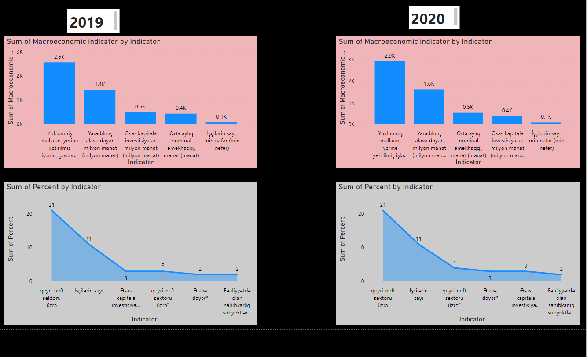
Difference between 2019 and 2020 based on macro-economic indicator and subject shares in small-entrepreneurship.

Slide 15
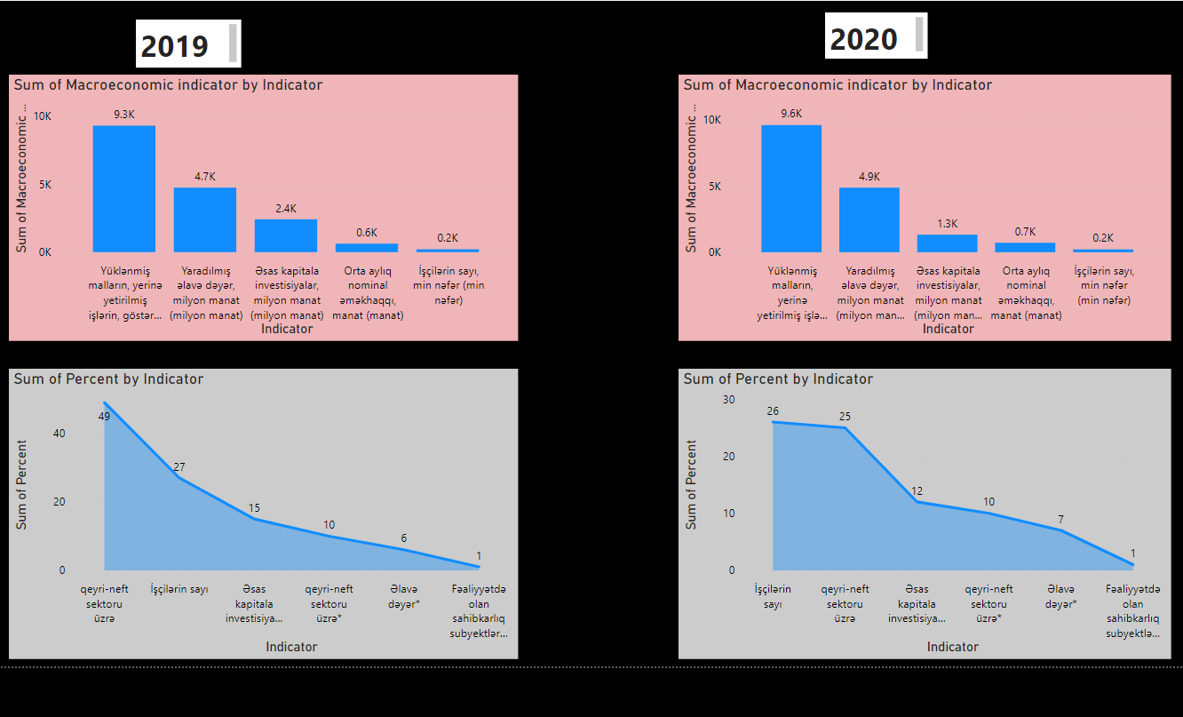
Difference between 2019 and 2020 based on macro-economic indicator and subject shares in medium-entrepreneurship.

Slide 16
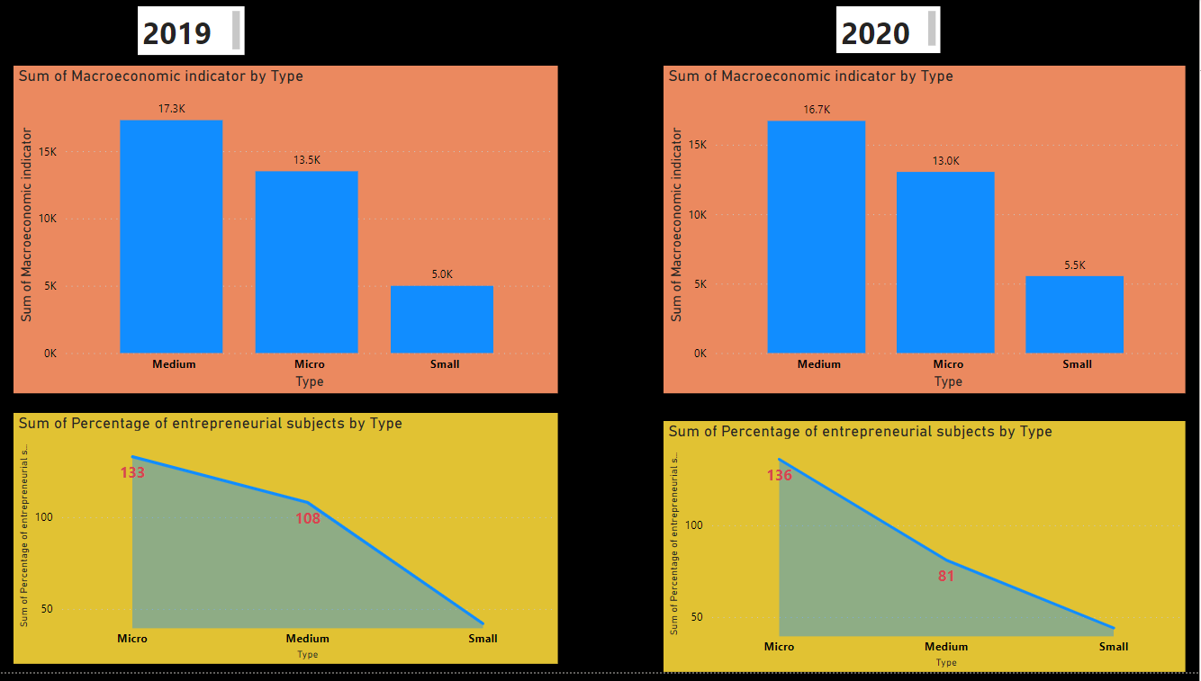
Distribution of the share of micro, small and medium subjects share and main macroeconomic indicators in 2019 and 2020.

Slide 17
Thank you for your attention! ☺

